Slide 1
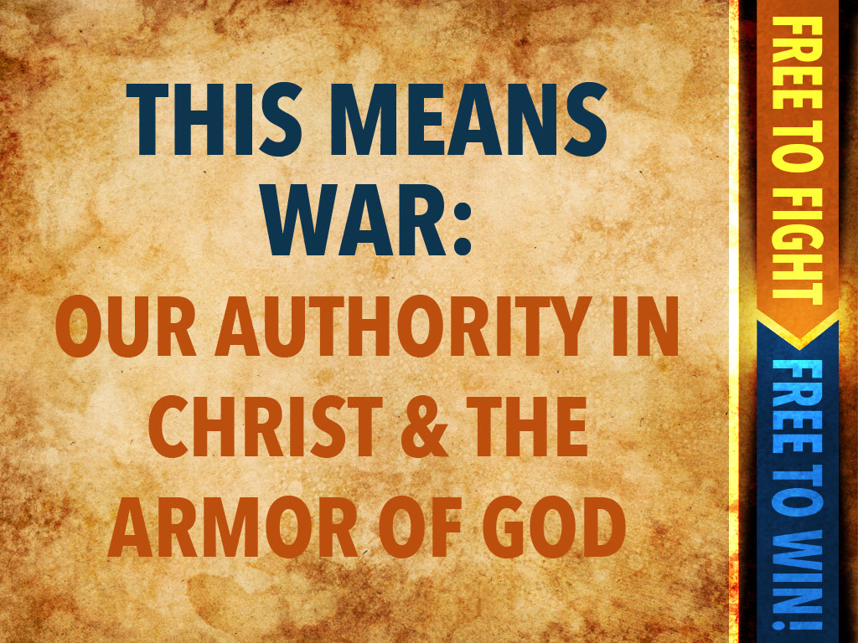

Slide 2
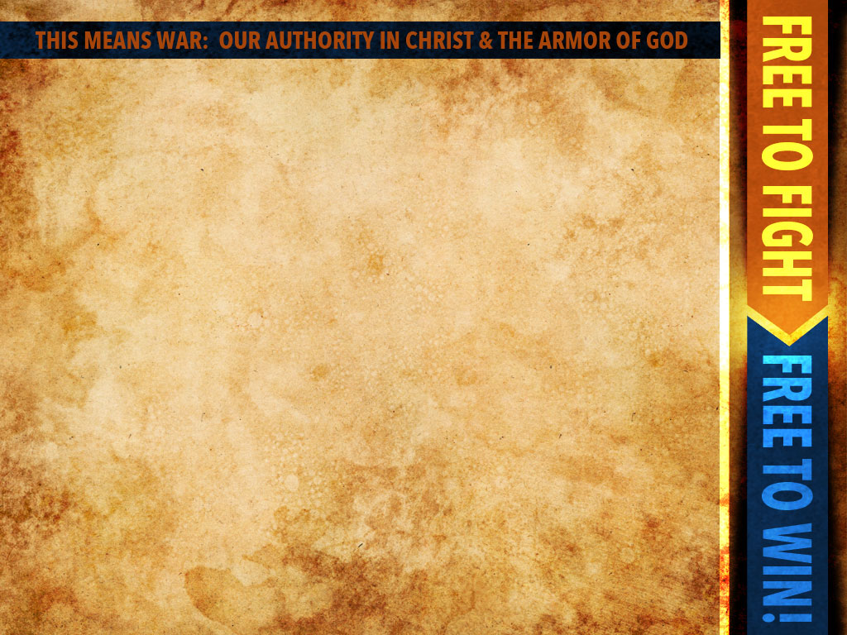
Most Christians are dangerously unaware of who they really are in Christ, and so they are impotent to exercise the spiritual authority that
they have in Him

Slide 3
Because of the ignorance, confusion, rebellion and division in the Church, Satan has been able to get away with murder.

Slide 4
It is long past time for the sleeping Church to awaken to the reality of the spiritual battle and the tremendous authority of the Lord Jesus and how He desires to exercise it through His unified, praying, submitted people.

Slide 5
We must understand the
difference between
power and authority.

Slide 6
Authority is…
“the right to give commands, enforce obedience, take action or make final decisions.”

Slide 7
Power is…
“the ability to do,
capacity to act, the capability to perform or produce.”

Slide 8
Scripture reveals the extent of Jesus’ power and authority
Jesus is God and in Scripture God is called “Almighty”
“Ah Lord God! Behold, You have made the heavens and the earth by Your great power and outstretched arm. There is nothing too hard for You” Jeremiah 32:17

Slide 9
Jesus has all authority in heaven and on earth. Before His resurrection, Jesus exercised authority over the devil by virtue of His life of perfect submission to the Father. After His resurrection, Jesus exercises authority by virtue of His position at the right hand of the Father.

Slide 10
We must come to understand our authority in Christ. The right hand of God is the place of all authority. Christ is now seated at God’s right hand Believers in Christ have been raised up and seated in the heavenly realms in Christ Jesus Jesus now exercises His authority through a united, submitted, praying Church.

Slide 11
Satan’s schemes of temptations, accusations, and deception are designed to usurp authority away from the Church. When we sin by rebelling against God and his human authorities, we fall right into a demonic trap!

Slide 12
We must exercise the spiritual
authority we have in Christ.
By faith (2 Cor. 5:7; Col 2:6)
In humility (John 15:5; 1 Peter 5:5-9; Luke 10:18-20)
With boldness (Acts 1:8; Prov. 28:1; 2Tim. 1:7)

Slide 13
We must be spiritually prepared to put on the armor of God (Ephesians 6:10-13)

Slide 14
We must be strong in the Lord and in the strength of His might (v.10)

Slide 15
We must know who our real enemy is (vv. 11,12)

Slide 16
We must realize this is an active, not passive war (vv. 12,13)

Slide 17
We must put on the full armor of God to stand firm against the enemies’ schemes (Ephesians 6:14-20)

Slide 18
This is a battle for our minds
(2 Corinthians 2:11;
2 Corinthians 10:3-5)

Slide 19
The belt of truth is our defense against deception
(Philippians 4:6-9)

Slide 20
The breastplate of righteousness is our defense against temptation and accusation

Slide 21
The sandals of the gospel of peace are our defense against anxiety, uncertainty and trouble (1 Peter 5:7,8)

Slide 22
The shield of faith is our defense against the fiery missiles of doom, gloom, discouragement and despair
(Psalm 18:1-6)

Slide 23
The helmet of salvation is our defense against condemnation and the prospect of harm or death (Romans 8)

Slide 24
The sword of the Spirit and prayer are our offensive weapons to come to the aid of our brothers and sisters in Christ and to boldly preach the good news (vv.17b-20)

