Slide 1


Slide 2
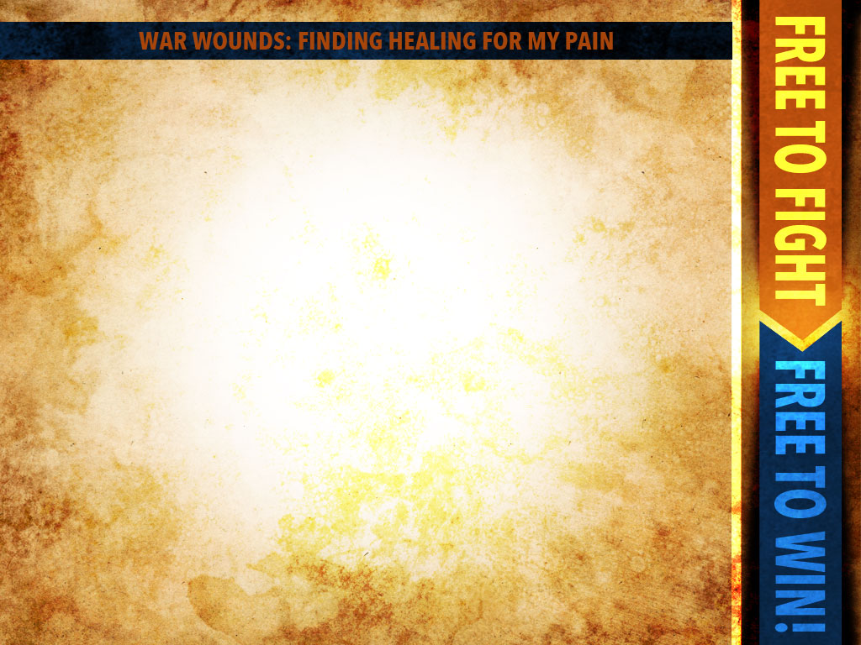
John 5:4
An angel of the Lord went down at certain seasons into the pool and stirred up the
water; whoever then first, after the stirring up of the water, stepped in was made well from whatever disease…

Slide 3
with which he was afflicted. 5A man was there who had been ill for thirty- eight years. When Jesus saw him lying there, and knew that he had already been a long time in that condition, He said to him, “Do you wish to get…

Slide 4
well ?” 7The sick man answered Him, “Sir, I have no man to put me into the pool when the water is stirred up, but while I am coming, another steps down before me.”

Slide 5
Matthew 8:16
When evening came, they brought to Him many who were demon-possessed; and
He cast out the spirits with a word, and healed all who were ill. 17This was to fulfill what was spoken through…

Slide 6
Romans 8:26
In the same way the Spirit also helps our weakness; for we do not know how to pray as we should, but the Spirit Himself intercedes for us with groanings too deep for words.

Slide 7
Astheneia- Infirmity-
weakness, lack of strength, frailty, feebleness, sickness of the soul, lack of capacity.

Slide 8
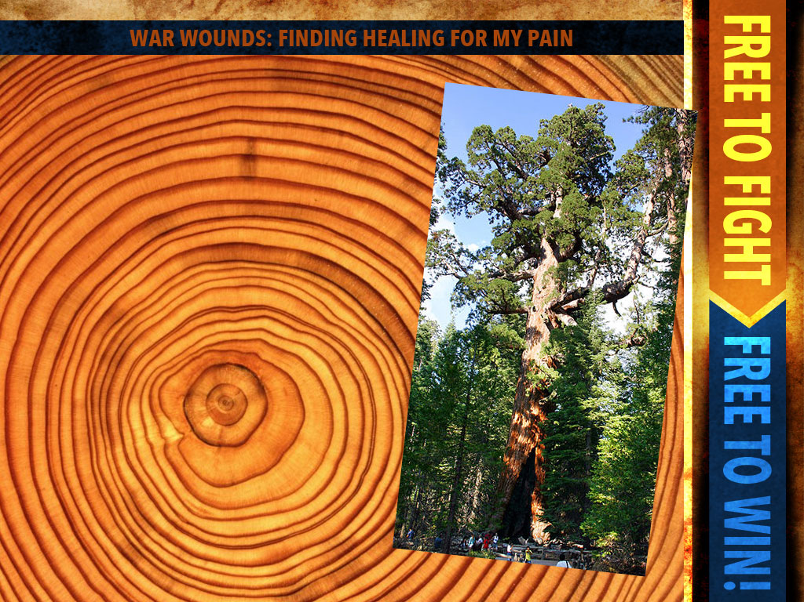

Slide 9
Four Sources From Which We Get Our Self Concept.
The outer world around us.
The inner world within us.
The satanic world beneath us.
The spiritual world above us

Slide 10
Results of Infirmities
1- Low self worth
Low self-worth will paralyze your potential.
Low self-worth will destroy your dreams.
Low self-worth will destroy your relationships.
Low self-worth sabotages your Christian service.

Slide 11
Results of Infirmities
1- Perfectionism
2- Super sensitivity
3- Fear
4- Anger

Slide 12
God’s provision for the healing of damaged emotions

Slide 13
1- A Loving Father
Psalm 56:8 You have taken account of my wanderings; Put my tears in Your bottle. Are they not in Your book?

Slide 14
2-An Empathetic Savior
Hebrews 4:15 For we have not an high priest which cannot be touched with the feeling of our infirmities; but was in all points tempted…

Slide 15
like as we are, yet without sin. 16Let us therefore come boldly unto the throne of grace, that we may obtain mercy, and find grace to help in time of need.

Slide 16
Hebrews 5:7
In the days of His flesh, He offered up both prayers and supplications with loud crying and tears to the One able to save Him from death, and He was heard because of His piety.

Slide 17
P.T. Forsythe-The Justification of God
“In the cross, God demonstrated his total identification with us in our undeserved suffering, as well as in our deserved punishment.”

Slide 18
P.T. Forsythe-The Justification of God
“In the cross, God demonstrated his total identification with us in our undeserved suffering, as well as in our deserved punishment.”

Slide 19
3-An interceding Spirit
Romans 8:26 In the same way the Spirit also helps our weakness; for we do not know how to pray as we should, but the Spirit Himself intercedes for us with…

Slide 20
groanings too deep for words; 27and He who searches the hearts knows what the mind of the Spirit is, because He intercedes for the saints according to the will of God.

Slide 21
David Seamands-
“The fact that God not only knows and cares, but fully understands is the most therapeutic factor in the healing of our damaged emotions.”

Slide 22
4-Our Role in Healing
Healing begins when we make the choice to forgive from our hearts those who have hurt us

Slide 23
Ephesians 4:32
Let all bitterness and wrath and anger and clamor and slander be put away from you, along with all malice. Be kind to one another, tender-hearted, forgiving each other…

Slide 24
Ephesians 4:32 cont’d
…just as God in Christ also has forgiven you.
Will you extend the same undeserved mercy and grace to others that God gave to you?

Slide 25
Your freedom and healing largely rest on how you respond to God’s call to forgive.

