Slide 1


Slide 2


Slide 3

Genesis 2:25
And the man and his wife were both naked and were not ashamed.

Slide 4
Genesis 3:6 When the woman saw that the tree was good for food, and that it was a delight to the eyes, and that the tree was desirable to make one wise, she took from its fruit and ate; and she gave also to her husband with…

Slide 5
her, and he ate. ⁷ Then the eyes of both of them were opened, and they knew that they were naked; and they sewed fig leaves together and made themselves ^{[b]}loin coverings. ⁸ They heard the sound of the Lord God…

Slide 6
walking in the garden in the ^{[c]}cool of the day, and the man and his wife hid themselves from the presence of the Lord God among the trees of the garden. ⁹ Then the Lord God called to the man, and said to him,…

Slide 7
“Where are you?” ¹⁰ He said, “I heard the sound of You in the garden, and I was afraid because I was naked; so I hid myself.”

Slide 8
Where did shame
start for you?
Culture | Family | Past Sin

Slide 9


Slide 10
Proverbs 18:13
He who gives an answer before he hears, It is folly and shame to him.

Slide 11
Proverbs 19:26
He who assaults his father and drives his mother
away is a shameful and disgraceful son.

Slide 12
Proverbs 29:15
The rod and reproof give wisdom, But a child who gets his own way brings shame to his mother.

Slide 13


Slide 14
Proverbs 12:4
An excellent wife is the crown of her husband, But she who shames him is like rottenness in his bones.

Slide 15
What does shame look like?
Self-hatred or self-consciousness
Hiding your true self for fear of rejection
Anger toward those who caused your shame
Medicating to numb your pain and shame
Excelling in other areas to compensate for shame

Slide 16


Slide 17
Lying about your past
Pretending everything is OK
Blame-shifting
Compromising moral or
biblical values
Compensating for areas of shame
by seeking to excel in others
Criticizing others who have the
same weaknesses as you
Self-medicating to numb the pain

Slide 18


Slide 19


Slide 20
Psalm 25:20
Guard my soul and deliver me; Do not let me be ashamed, for I take refuge
in You.

Slide 21
Psalm 31:17
Let me not be put to shame, O Lord, for I call upon You.

Slide 22
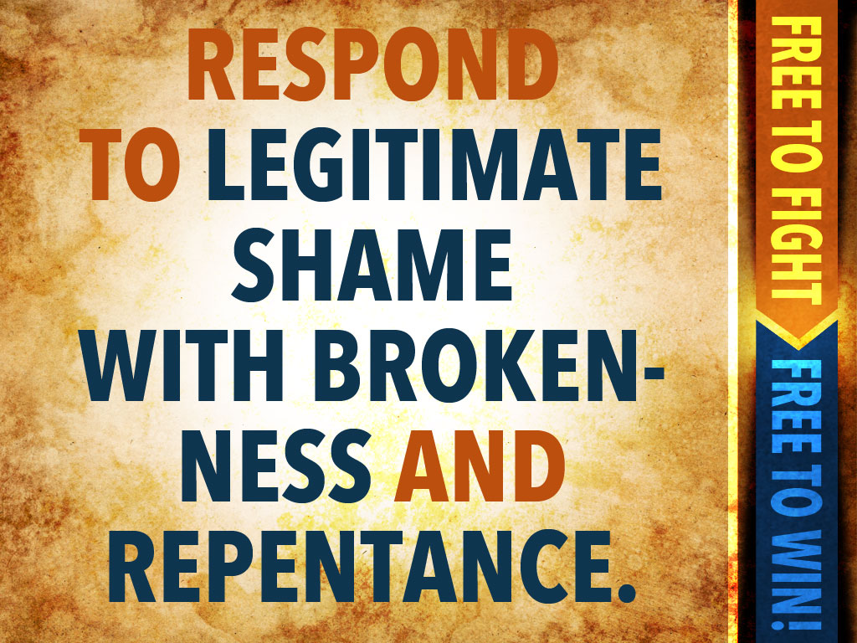

Slide 23
1 Corinthians 4:14
I do not write these things to shame you, but to admonish you as my beloved children.

Slide 24


Slide 25
Hebrews 12:2
fixing our eyes on Jesus, the author and perfecter of faith, who for the joy set before Him endured the cross, despising the shame, and has sat down at the right hand of the throne of God.

Slide 26


Slide 27
1 Peter 4:16
but if anyone suffers as a Christian, he is not to be ashamed, but is to glorify God in this name. Embrace your new place of honor clothed in the righteousness of Christ.

Slide 28
Revelation 3:18
I advise you to buy from Me gold refined by fire so that you may become rich, and white garments so that you may clothe yourself, and that the shame of your nakedness will not be revealed.

Slide 29


Slide 30
2 Corinthians 5:21
For our sake he made him (Jesus) to be sin who knew no sin, so that in him we might become the righteousness of God.

