Slide 1
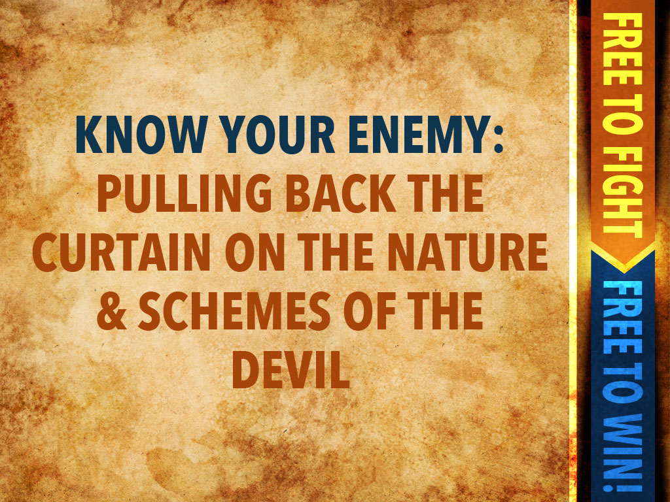

Slide 2


Slide 3

About Angels
Angels were originally created by Christ and for Christ
(Colossians 1:15-17)

Slide 4
Holy angels are ministering spirits
(Hebrews 1:14)

Slide 5
They sometimes appear as humans
(Hebrews 13:2)

Slide 6
They rarely give out their names
(Luke 1:19; Daniel 10:13)

Slide 7
They bring a message and then leave, but never establish an ongoing relationship with a person.

Slide 8
They do not receive worship, but direct worship to God and are themselves worshipers.
(Revelation 19:10; Revelation 5:11,12)

Slide 9
About demons
They are unclean spirits (Matthew 10:1), often establishing themselves as local gods to be worshiped (Deuteronomy 12:16-18)

Slide 10
They seek to influence and even control people, even believers
(Acts 5:1,2)

Slide 11
They can exhibit supernatural strength and even perform miracles
(Mark 5:2-4;
2 Thessalonians 2:8-10)

Slide 12
They try to incite self-destructive behavior in their victims
(Mark 5:5)

Slide 13
They can cause physical illness
(Luke 13:11)

Slide 14
Their intention is to lead people into following human reasoning and man’s interests rather than on God’s
(Matthew 16:22,23)

Slide 15
Demonic strategies

Slide 16
The devil’s overall purpose
is to become more real to people than God is and therefore steal glory from God and get men to fear
and serve demons rather than the Lord
(Isaiah 14:13,14; 1 Peter 5:8)

Slide 17
Temptation
Temptation is Satan’s strategy to try and entice us to not wait for God or trust in His ways, but to meet our own needs independently of God (Matthew 4:1-11; 1 John 2:15-7)

Slide 18
Accusation
Accusation is Satan’s strategy to try and convince us that we are less than who God says we are in Christ (Revelation 12:10; Zechariah 3:1-7)

Slide 19
One of the severest tests of accusation is when you are accused of having blasphemed the Holy Spirit (Matthew 12:30-32)

Slide 20
Deception
Deception is Satan’s strategy to lure people into believing in his counterfeit guidance in terms of false prophets, false teachers, false doctrine, false religions; even masquerading as the voice of God or a…

Slide 21
holy angel or even your own voice (2 Corinthians 11:1-5; 12-15; Deuteronomy 13:1-5; 18:9-14)

Slide 22
Opposition
Opposition is Satan’s strategy to hinder the forward work of God’s kingdom through utilizing people and circum-stances; he will even go so far as to use persecution, imprisonment and even...

Slide 23
murder to try and stop God (1 Thessalonians 2:18; John 10:10; John 8:44; Revelation 2:10)

Slide 24
“The prince of darkness grim; we tremble not for him. His rage we can endure, for lo his doom is sure. One little word shall fell him!” A Mighty Fortress is our God
(2 Thessalonians 3:1-3)

